Slide 1
Yelp Ratings Upgraded
By: Ammar Karim, XiuXang Jin, YuHao Liu, Zeqiang Lin

Slide 2
RoadMap/Blocks
1st
2nd
3rd
4th
Keyword Extraction
Rating Extraction
Weighted Suggestions
Revised Suggestion
Finding Keywords from user reviews
Create ratings based on Keywords
Provide suggestions to user based on new ratings
Allow Users to improve suggestions

Slide 3
Keyword Extraction
We are using rake_nltk library to do keyword extraction
The total keywords: 5565
We stored it in a file with score.

Slide 4
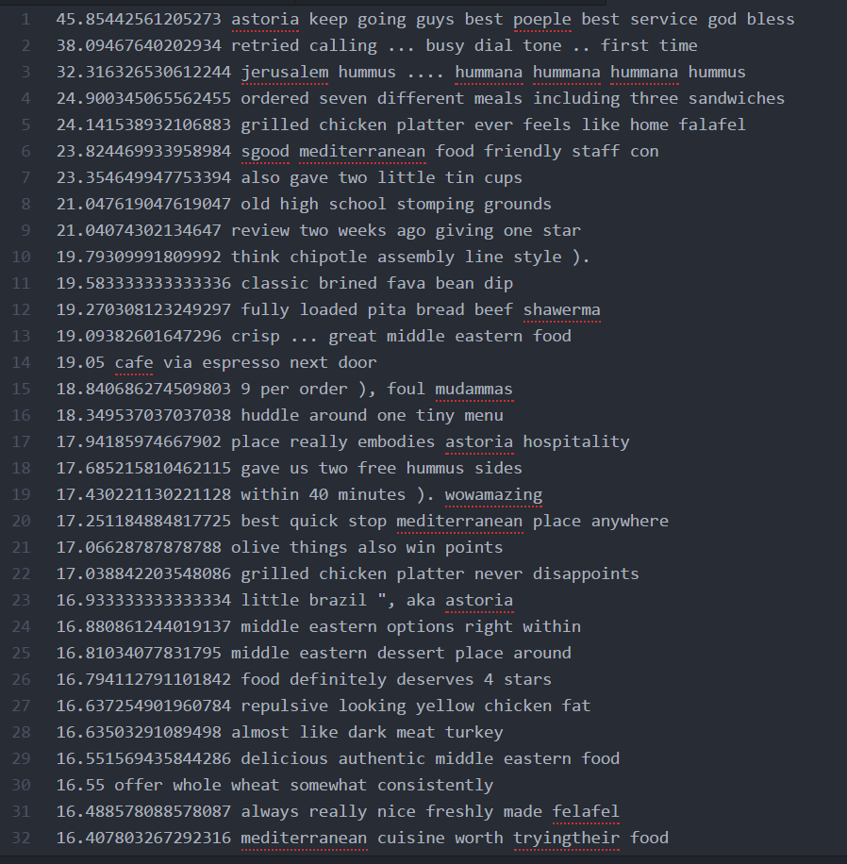
The output

Slide 5
Rating Extraction
Overview
Keyword Extraction (just mentioned)
Aggregate Similar Words
Estimate Sentiment for Words
Aspect based sentiment analysis
Input of previous keyword extraction enriched with tags of type + or -
Positive: nice, awesome, cool, superb
Negative: uninspired, expensive, disappointed, avoid

Slide 6
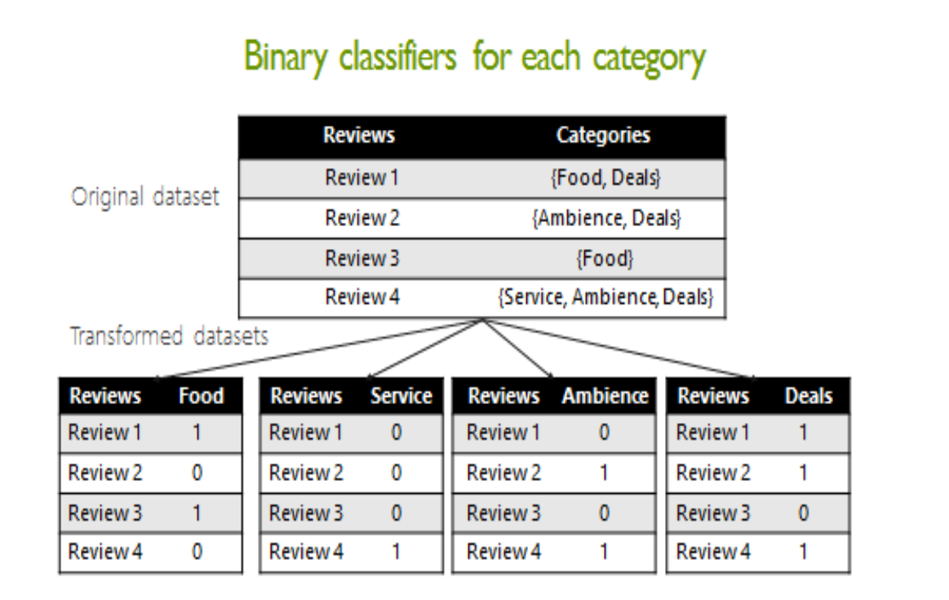
Machine learning: classifier

Slide 7
References
https://arxiv.org/pdf/1702.02540.pdf
https://arxiv.org/pdf/1612.08220.pdf

